Slide 1
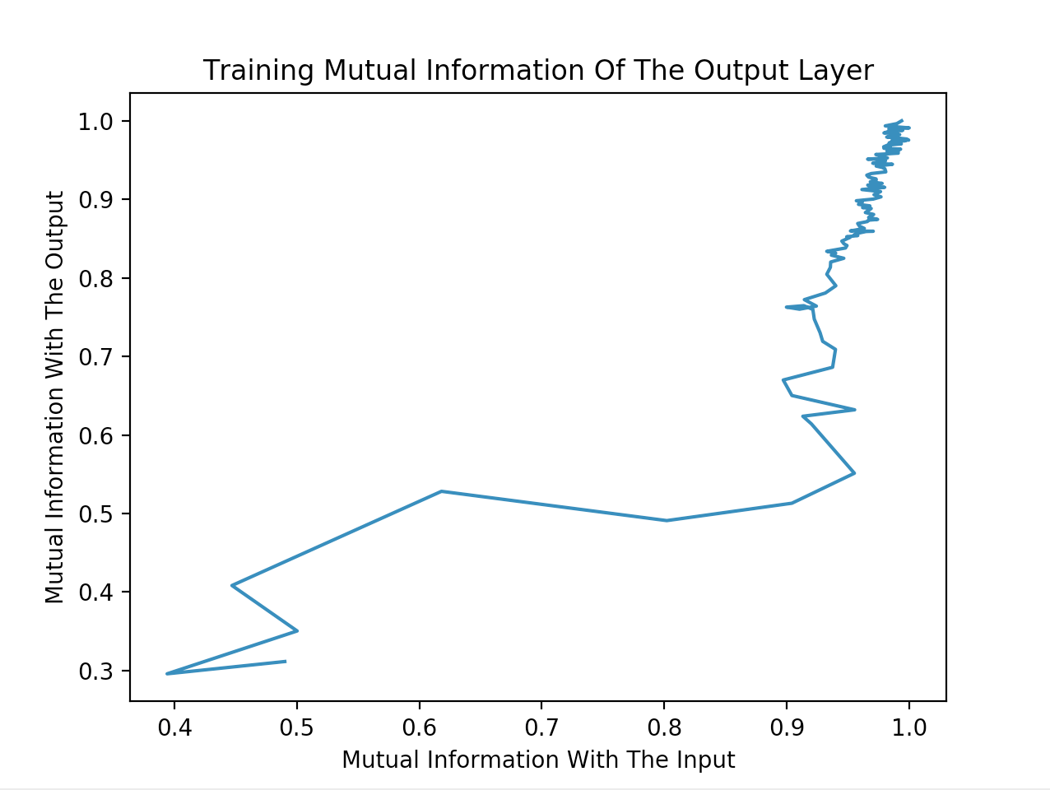
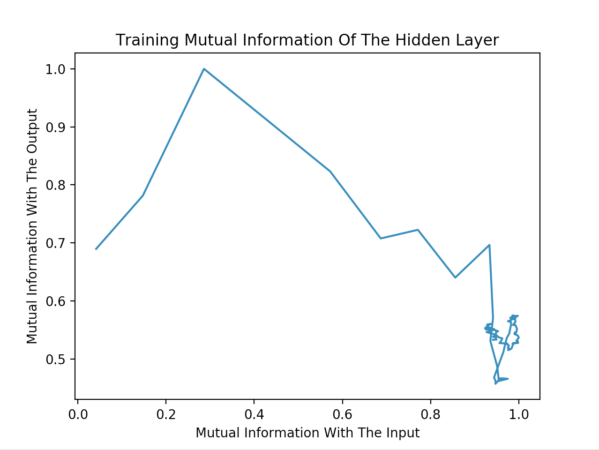
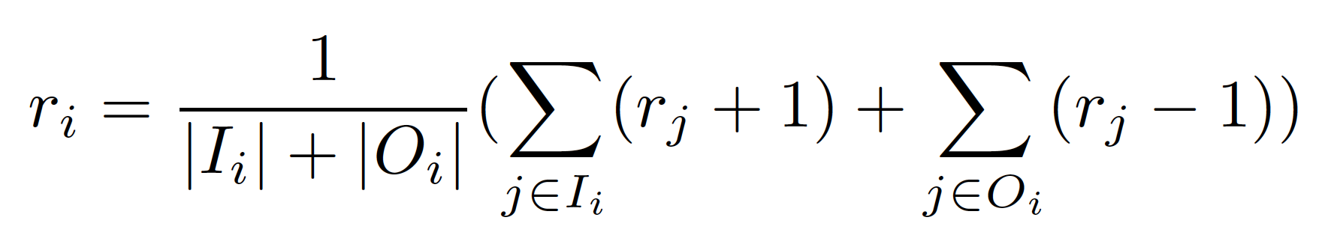
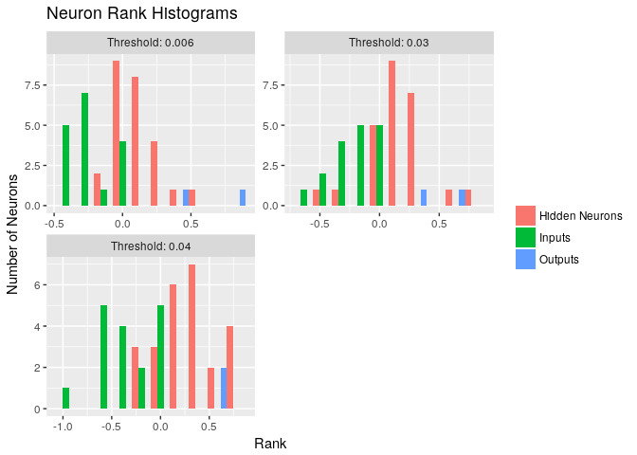
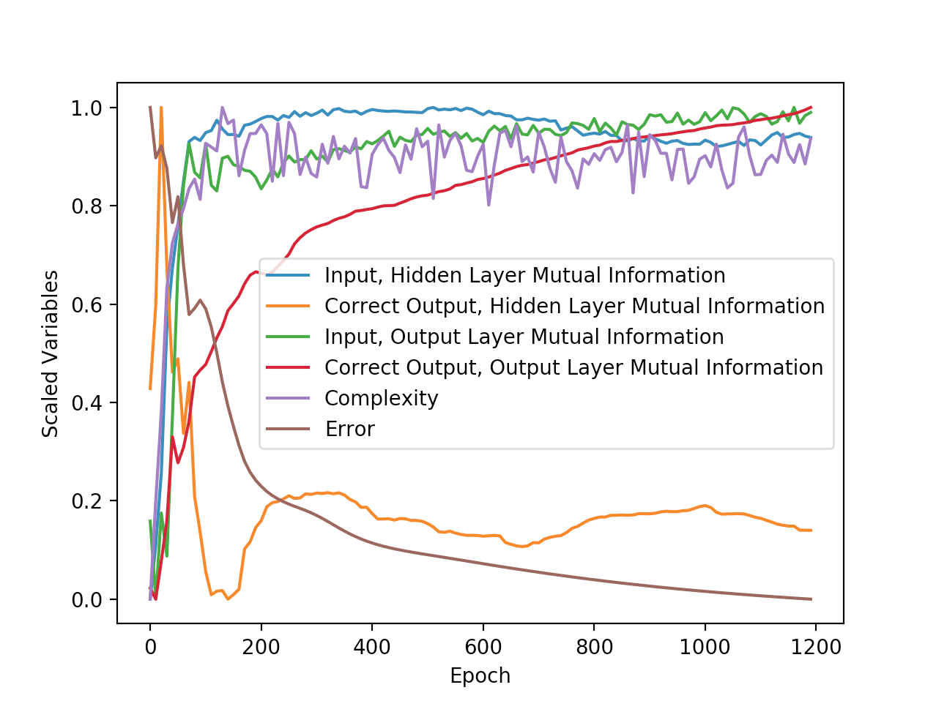
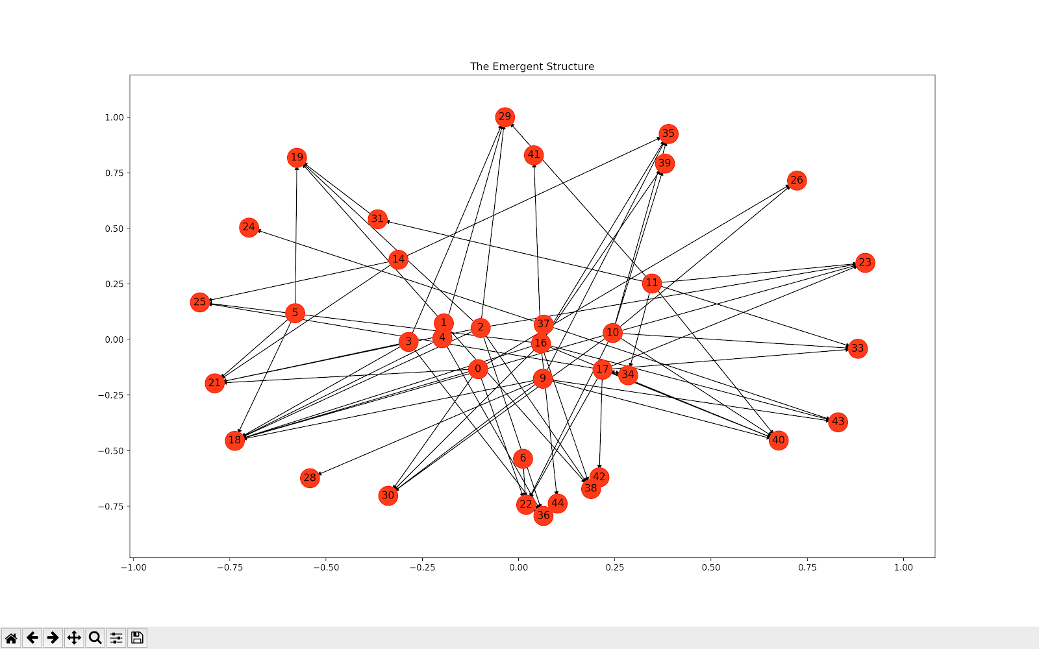
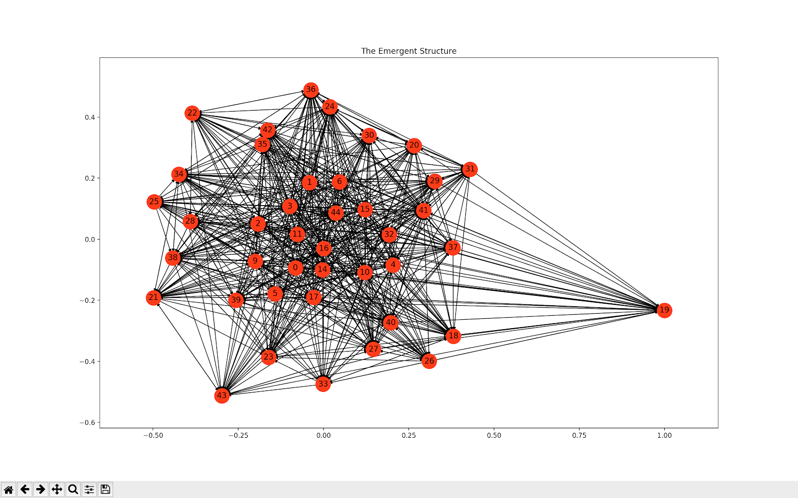
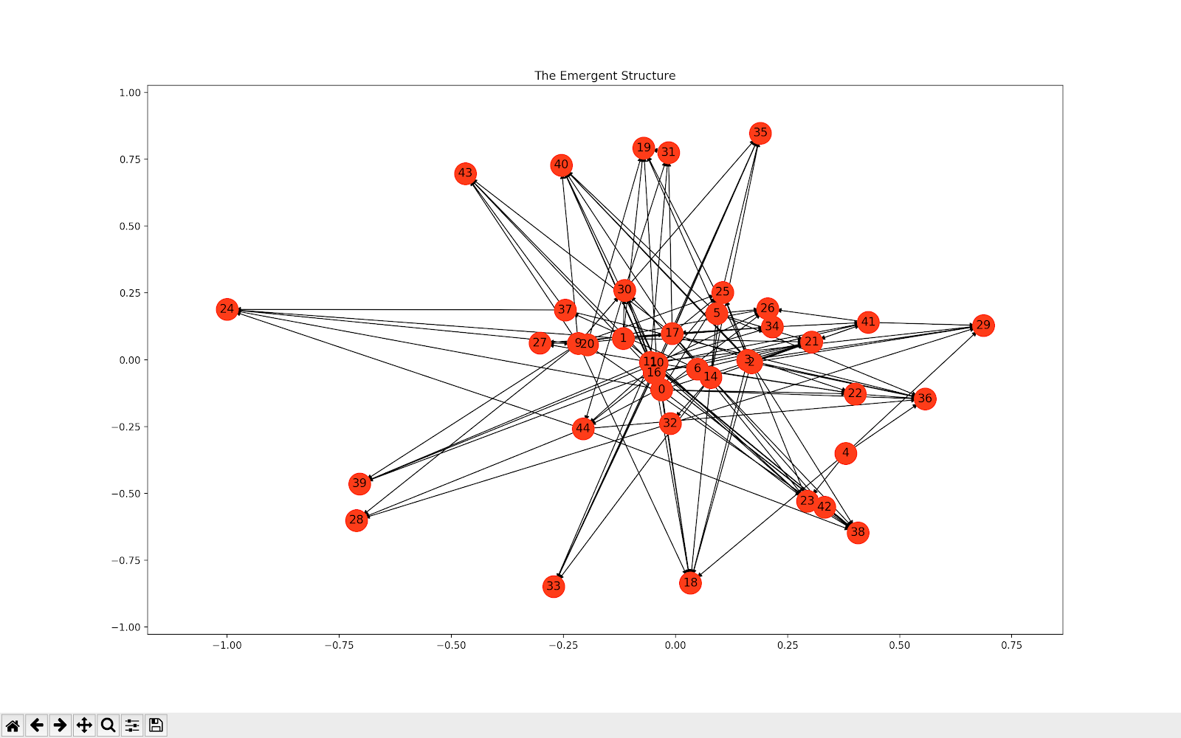
Applying Information Theory to
Fully Recurrent Neural Networks
Stefan Ivanovic, Benjamin Kha, Vignesh Muruganantham
Motivation
The Neural Network
Information Bottleneck
Our fundamental motivation is understanding neural networks. To do so, we look at fully recurrent neural networks since very little structure is imposed on them, so almost any structure we find was naturally developed during training. We choose to use information theory as it has been the most fruitful method of understanding neural networks thus far. We choose to both investigate methods which have been successful on feedforward neural networks (the information bottle principle and learning indicators) and invent new methods designed with recurrent neural networks in mind (the information flow graph and the ranking algorithm).
In this study we use a fully recurrent neural network with the standard backpropagation through time training algorithm.
The network was trained to predict the temperature at airports using weather data from previous days.
We chose to work with a fully recurrent neural network since their is very little structure imposed on it, which allows us to analyze how structure naturally develops during training.
We trained on individual airports, then on regional data.
We analyzed how the mutual information of the networks layers with the input and ground truth output develop during training. The information bottleneck principle suggests that the mutual information with the input first increases, but eventually begins to decrease. This is not what we found. In fact, we find very odd behavior.
We also analyzed the mutual information of each individual neuron with the input and ground truth output (and found a positive correlation).
Abstract
In this paper, we use information theory to analyze a fully recurrent neural network. The neural network is trained to predict daily temperatures from weather data in the past several days. We analyze if a natural structure develops in the network (since there is very little structure imposed on a fully recurrent neural network). To do this, we form graphs of the information flow in the network and develop an ranking algorithm to help analyze its structure. We find only slight traces of a structure developing on the network. We also analyze how information theory related statistics can be used as learning indicators. Additionally, we look at whether the information bottleneck principle appears to apply to fully recurrent neural networks (as it has been shown to apply to feed forward neural networks). We find no indication that the information bottleneck principle still applies.
Ranking
Our ranking algorithm measures the “rank” of a neuron which represents how “far along the network” each neuron. This algorithm takes the information flow graph as an input and helps us analyze the structure of the network.
The following is the ranking algorithm (please reference the paper for details):
We analyzed the ranking of the neurons for several different information flow cut off points. We found that for all choices of cut-off point, the inputs were generally ranked before the hidden neurons which were generally ranked before the outputs. This indicated that the ranking algorithm provided a valid measure for how far along the network each neuron is.
We noticed that although the ranking algorithm was working, it is still difficult to see any structure from the ranking (for example signs of layer like structures forming). Working with a higher number of neurons could make this much easier.
Learning Indicators
We analyzed how several information theory related statistics could be used as learning indicators (which show signs of learning before the error significantly decreases).
We found that the mutual information of either layer with the input is an effective learning indicator.
We also found that the complexity of the network behaves very similarly to the mutual information with the input and is an equally effective learning indicator.
We saw that the mutual information between the output layer and ground truth output behaves nearly identically to the error as expected.
We saw that the mutual information between the hidden layer and the ground truth output has very odd behavior and is not a useful learning indicator.
Information Flow Graph
We defined the information flow between two neurons as their time delayed mutual information minus their regular mutual information. This gives a nice way of measuring how much one neuron directly influences another neuron (and mostly removes confounding effects such as both variables being dependent on a third variable).
We created several directed graphs where an edge from neuron A to neuron B represents there being high information flow from neuron A to neuron B. This is useful for analyzing the structure of information flow in the network.
We confirmed the legitimacy of this approach using a ranking algorithm.
We found the results to be chaotic as is shown in the bellow image. We also applied several analyses to try to find patterns in the structure, but found no patterns, aside from the input degree and output degree being negatively correlated.
Figure 2. A chart showing the
different ranks of neurons at
different levels under our
ranking algorithm
Contact
References
Vignesh Muruganantham
UC Berkeley
34444 Colville Place
muruvig@gmail.com
(510) 386-9274

